Slide 1


Computing in Context: Fall 2024
Lab 8 |Pandas Pandas Pandas
Statistical brief overview
Dr Sarah Ashcroft-Jones | Mailman School of Public Health

Slide 2

Statistical brief overview
Section I| Material Review

Slide 3
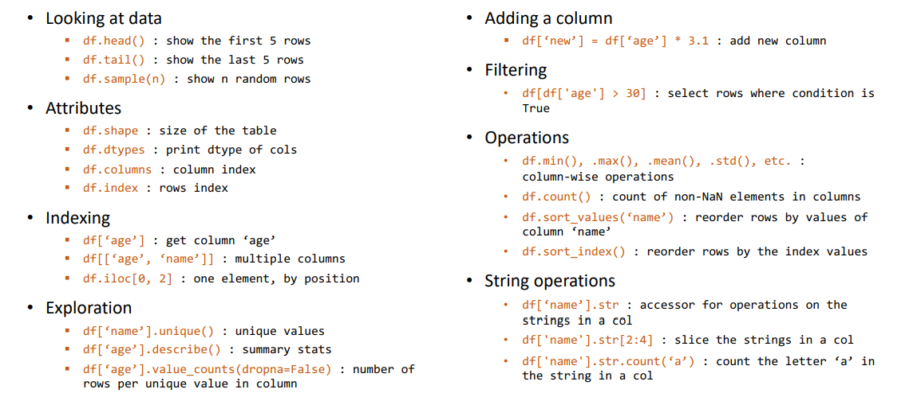

Slide 4
Statistical brief overview
In lab work time

Slide 5
Statistical brief overview
End of session:
Questions?

